Slide 1

Route-Optimization & Load Distribution with Machine Learning
Project by
Aarthi Ashokan (aa2198)
16:540:588 – AI in Decision Making

Slide 2
PROBLEM STATEMENT
Many offices provide cab services to its employees after late hours, and they may spend a lot of time in dropping off their employees to different locations due to
Inefficient route allocations
Unmanaged employee (location) distribution between cabs
First part of the problem deals with designing
an optimal route for a cab from office to different
drop-off locations and then back to office.
Second part deals with optimal distribution of drop-off requests between two cabs.
Inefficient route
Efficient route
Unmanaged distribution
Managed distribution

Slide 3
MOTIVATION
Reduced travel distance
Cost/Expense reduction
Avoid repetitive routes
Improve vehicle utilization

Slide 4
Data
Data consists of NYC Yellow Cab Trip records for the year 2016 from 1st January – 30th June and it was obtained from ‘’NYC Taxi and Limousine Commission (TLC) Trip Record Data “
Attributes of the dataset:
Id
Vendor Id
Pickup datetime
Dropoff datetime
Passenger count
Pickup longitude
Pickup latitude
Dropoff longitude
Dropoff latitude
﻿store_and_fwd_flag
Trip duration
Total number of observations 1458644

Slide 5
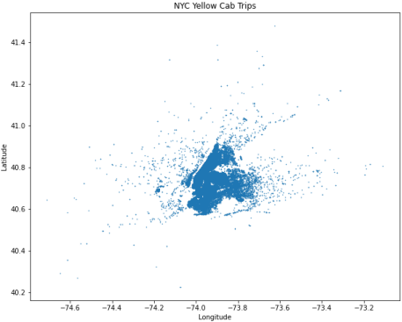
Data Preprocessing
Converted the trip duration to minutes
Features added - ﻿pickup_month, ﻿pickup_date, year, ﻿pickup_hour, pickup_minutes and ﻿trip_distance
Calculated trip distance in miles between each pickup and dropoff locations using haversine formula
Filtered data such that only locations of Manhattan are presents
New size of the dataset – 678309 observations and 17 attributes

Slide 6
Models used to predict trip duration
Linear Regression
XGBoost Regressor

Slide 7
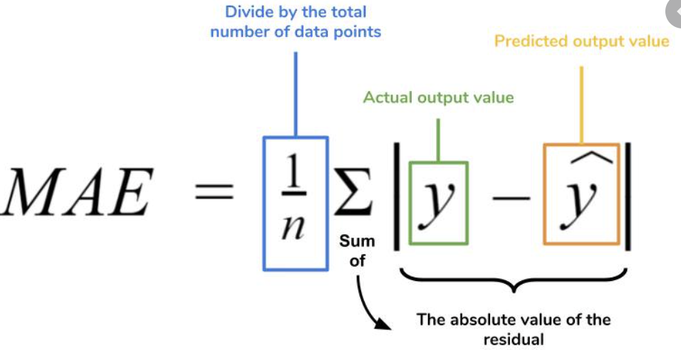
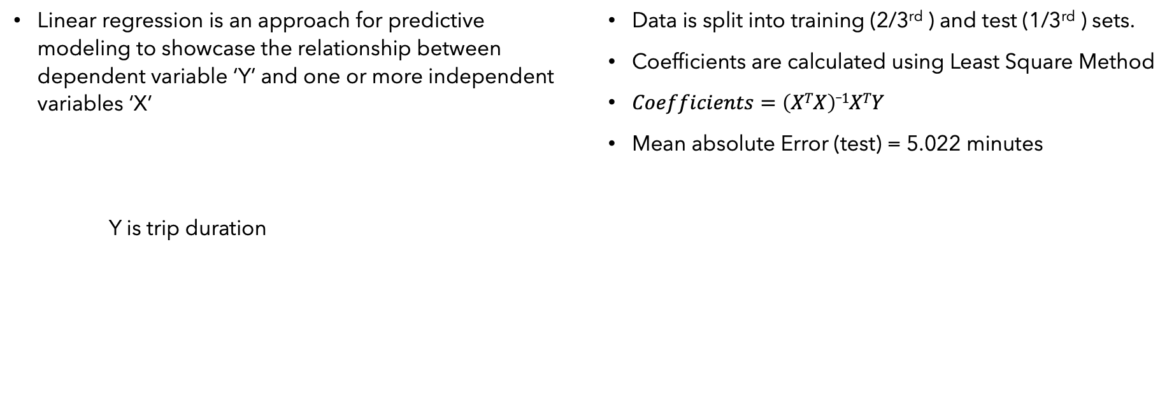
Linear Regression
Linear regression is an approach for predictive modeling to showcase the relationship between dependent variable ‘Y’ and one or more independent variables ‘X’
Y is trip duration
Data is split into training (2/3rd ) and test (1/3rd ) sets.
Coefficients are calculated using Least Square Method
$Coefficients=\left(XTX\right)_1XTY$
Mean absolute Error (test) = 5.022 minutes

Slide 8
XGBoost Regressor
Stands for eXtreme Gradient Boosting
XGBoost is a decision-tree based ensemble machine learning algorithm that uses a gradient boosting framework.
Decision tree gets trained on the residual value.
Data Set: (X₁, X₂,….,X_{n}, Y)
Base Model: Y₀
Compute Residuals
Decision Tree 1
Decision Tree 2
Decision Tree m
... m-1 …
Compute Residuals
Compute Residuals
Output Y₁ = Y₀ + (⍺₁* T₁)
Output Y₂ = Y₀ + (⍺₁* T₁) + (⍺₂* T₂)
Output Y_{m} = Y₀ + (⍺₁* T₁) + (⍺₂* T₂)+…+ (⍺_{m}* T_{m})

Slide 9
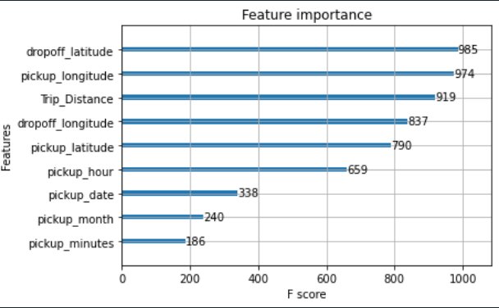
XGBRegressor model results
Mean absolute error (test) = 3.47545 minutes
Feature Importance
The most valuable features in the prediction of
trip duration are:
Dropoff_latitude
Pickup_longitude
Trip_Distance
Dropoff_longitude
Pickup_latitude
Pickup_hour

Slide 10
Optimization with Genetic Algorithm
Genetic Algorithms are the heuristic search and optimization techniques that mimic the process of natural evolution.
This GA model has the following steps:
Create the population
Calculate the fitness
Select the parents
Breed
Repeat
“ Select The Best, Discard The Rest”
Constraints of our problem:
We must start from office, cover all the locations and return back to office.
All the locations need to be visited exactly once

Slide 11
Genetic Algorithm Steps
Test Locations
Get locations of employee requiring cab service
L1, L2, L3, L4, L5, L6
Create the population
Single Route: ﻿['Of', 'L6', 'L4', 'L5', 'L2', 'L1', 'L3', 'Of’]
Population: collection of all possible routes
Calculate fitness score
Fitness score: Total trip duration of each route which is
calculated from the XGBoostRegressor model
Selecting the parents
Parents are selected from the population to create next generation.
Selection is based on fitness.
Lowest fitness score means shortest time and is ranked first.
Breed
Child is created to include all test locations exactly once using ordered crossover
Subset of parent1 is randomly selected and remaining is filled with genes from parent2

Slide 12
Route Optimization Results

Slide 13
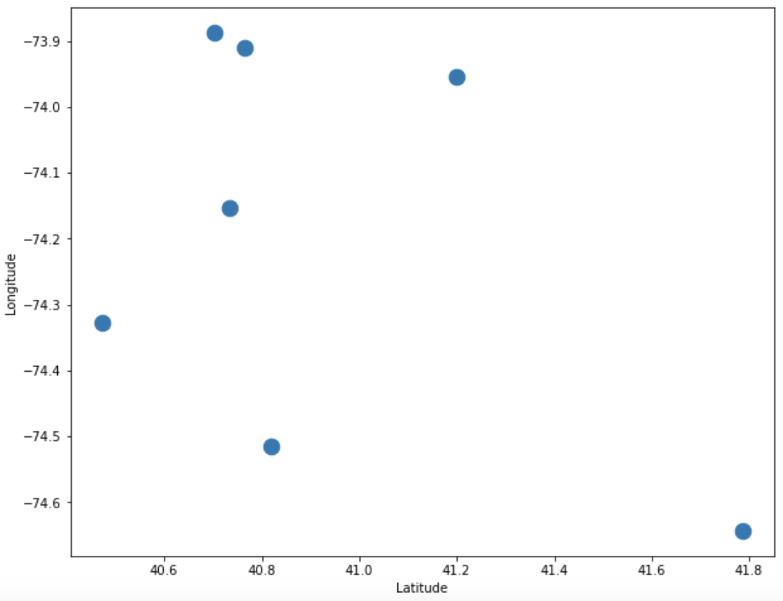
Route Optimization Results
ROUTE 1
Routes assigned on first-come-first-serve basis
OF-L1-L2-L3-L4-L5-L6-OF
Total Trip Duration = 458.5956 min
ROUTE 2
Routes assigned randomly
OF-L6-L4-L3-L5-L1-L2-OF
Total Trip Duration = 399.6468 min
Office
ROUTE 3 with Genetic Algorithm
Routes are decided based on Genetic Algorithm
OF-L6-L4-L2-L1-L3-L5-OF
Total Trip Duration = 238.7878 min
Office
Office
1
3
1
3
1
3
5
5
5
2
2
2
6
Route with the lowest time in transit
6
6
4
4
4

Slide 14
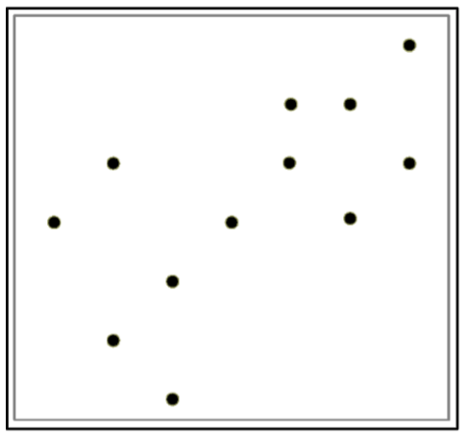
Load Distribution With Constrained Clustering
K-means Clustering Algorithm
1) Set k=2
2) Randomly partition data points into k groups with max cluster size = 6
3) Compute
centroids
4) Assign each object to cluster with nearest centroid
Data points
5) Recompute centroids
6) Repeat step 4) & 5)
Stop when there is no change in assignment

Slide 15
Load Distribution Results

Slide 16
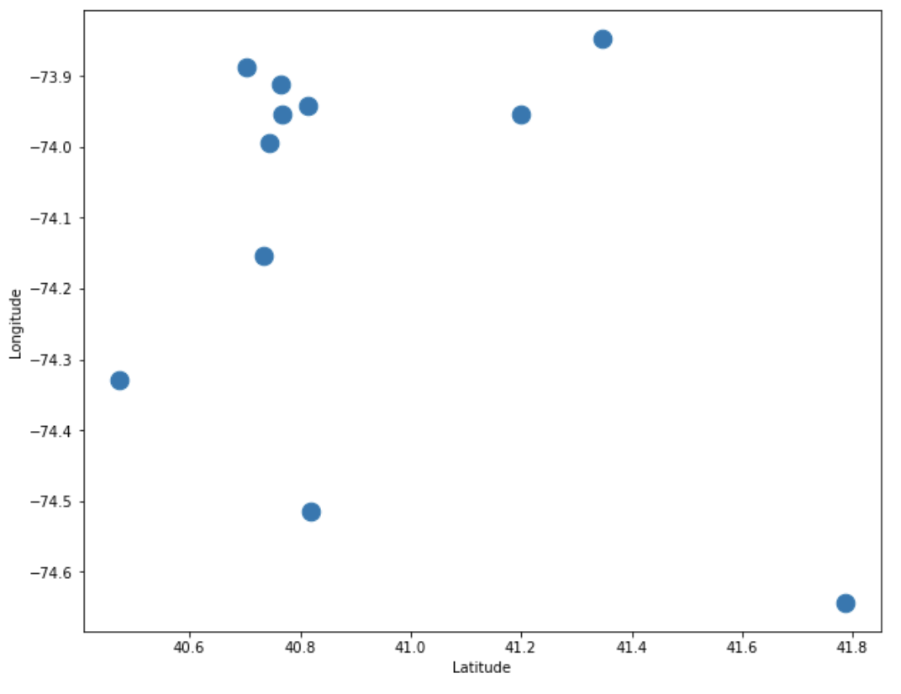
Standard Approach
Capacity per cab is 6 employees/requests
Requests are distributed between two cabs on first-come-first-serve basis and on cab’s capacity
Routes are randomly decided
Route for CAB-1
OF-L2-L5-L4-L1-L3-L6-OF
Trip Duration = 457.655 min
Route for CAB-2
OF-L8-L7-L10-L9-OF
Trip Duration = 222.934 min
Total transit time for both the cabs = 680.589 min
Office
3
9
10
8
4
7
5
6
1
2

Slide 17
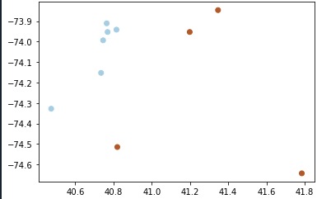
Proposed Approach
Locations are clustered together based on closeness and cab’s capacity and all locations in one cluster are assigned to one cab
For each cluster, route is decided by applying genetic algorithm
Route for cab 1
OF-L9-L4-L2-L1-0F
Trip Duration = 212.3513 min
Route for cab 2
OF-L6-L8-L10-L3-L7-L5-OF
Trip Duration = 167.5949 min
Total transit time for both the cabs = 379.946 min
Longitude
Latitude

Slide 18
THANK YOU !!

